Slide 1
Chapter 10. Applying Responsibility Assignment Patterns (Part 1)
Design Pattern Introduction
MVC

Slide 2
Key Takeaway Points
Design patterns are abstractions of proven design solutions to commonly encountered design problems.
The controller, expert, and creator patterns are applicable to almost all object oriented systems.
10-<number>

Slide 3
Applying Patterns in the Methodology Context
Business goals
& needs
Current situation
Use case-iteration allocation matrix
Accommodating
Requirements Change
Customer
feedback
Acquiring
Requirements
(Domain Modeling)
Iteration use cases
Domain Modeling
Preliminary requirements
Domain model
Domain model
Deriving Use Cases
from Requirements
Actor-System Interaction Modeling
Abstract & high level use cases, use case diagrams
Expanded use cases & UI design
Allocating Use Cases & Subsystems
to Iterations
Behavior Modeling &
Responsibility Assignment
Behavior models
Use case-iteration allocation matrix
Deriving Design Class
Diagram
Producing an Architecture Design
Design class diagram
Software architecture
Test Driven Development, Integration, & Deployment
(a) Planning Phase
(b) Iterative Phase – activities during each iteration
control flow
data flow
control flow & data flow
10-<number>

Slide 4
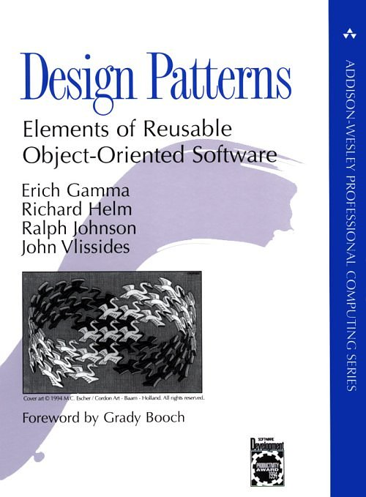
An Introduction to Design Patterns

Slide 5
Motivation and Concept
OO systems exploit recurring design structures that promote
  Abstraction
  Flexibility
  Modularity
  Elegance
Therein lies valuable design knowledge
Problem: capturing, communicating, and applying this knowledge
© E. Gamma, R. Helm, R. Johnson, J. Vlissides and Addison-Wesley

Slide 6
Gang of Four Patterns
Creational patterns deal with creation of complex, or special purpose objects.
Structural patterns provide solutions
for composing or constructing large, complex structures that exhibit desired properties.
Behavioral patterns are concerned with
  algorithmatic aspect of a design
  assignment of responsibilities to objects
  communication between objects
10-<number>

Slide 7
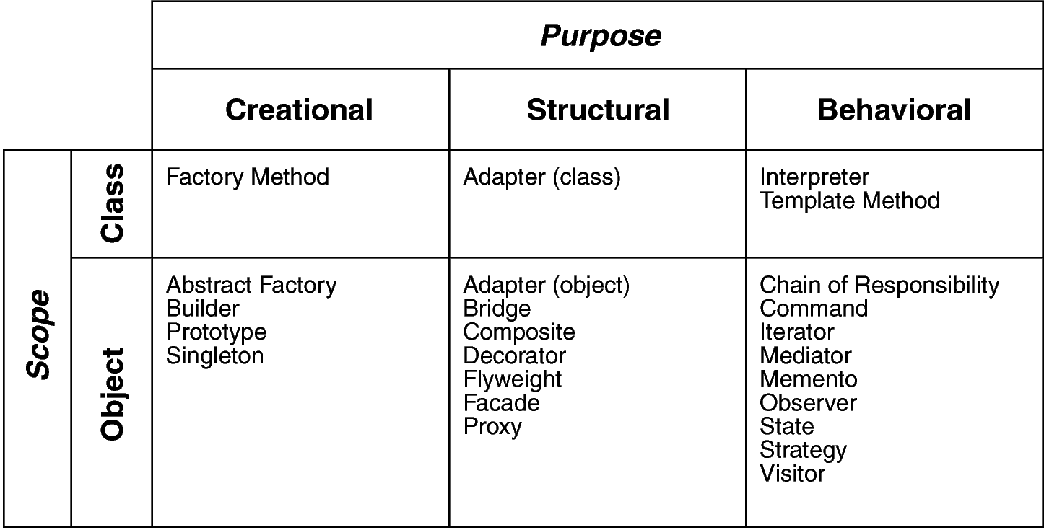
Design Space for GoF Patterns
Purpose: reflects what a pattern does
Scope: domain over which a pattern applies

Slide 8
Design Pattern Template scope purpose
Intent
  short description of the pattern & its purpose
Also Known As
  Any aliases this pattern is known by
Motivation
  motivating scenario demonstrating pattern’s use
Applicability
  circumstances in which pattern applies
Structure
  graphical representation of the pattern using modified UML notation
Participants
  participating classes and/or objects & their responsibilities

Slide 9
What Is a Design Pattern?
A design pattern
  Is a common solution to a recurring problem in design
  Each pattern solves a class of design problems
  Abstracts a recurring design structure
  Comprises class and/or object
    Dependencies
    Structures
    Interactions
    Conventions
  Names & specifies the design structure explicitly
  Design patterns improve communication among software developers
  Distils design experience and can be combined to solve a large complex design problem
© E. Gamma, R. Helm, R. Johnson, J. Vlissides and Addison-Wesley

Slide 10
Four Basic Parts
Name
Problem (including “forces”)
Solution
Consequences & trade-offs of application

Slide 11
Model-View-Controller

Slide 12
The MVC pattern
MVC stands for Model-View-Controller
The Model is the actual internal representation
The View is a way of looking at or displaying the model
The Controller provides for managing user input and modification
These three components are usually implemented as separate classes

Slide 13
The Model
The Model is the part that does the work--it models the actual problem being solved
The Model should be independent of both the Controller and the View
  But it provides services (methods) for them to use
Independence gives flexibility, robustness

Slide 14
The View
Typically, the user has to be able to see, or view, what the program is doing
The View shows what the Model is doing
  The View is a passive observer; it should not affect the model
The Model should be independent of the View, but it can provide access methods
The View should not display what the Controller thinks is happening

Slide 15
The Controller
The Controller decides what the model is to do, while the design of the Controller depends on the Model
Often, the user is put in control by means of a GUI. In this case, the GUI and the Controller are often the same
Combining the Controller and View is appropriate if they are very interdependent

Slide 16
Model-View-Controller (MVC)
Model
Program State
-data structures
View
Paint event
-display data
Controller
Interaction events
-modify data

Slide 17
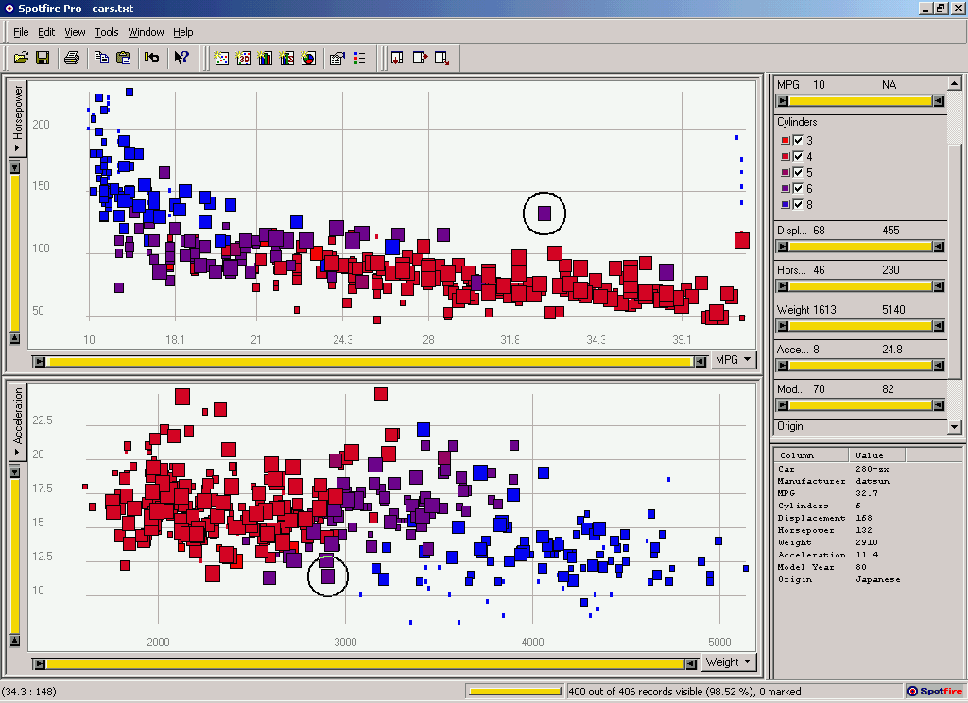
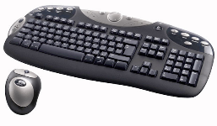
Model-View-Controller (MVC)
Code:
Data display
refresh
View
User input
Controller
UI:
events
refresh
manipulate
Data model
Model
Data:

Slide 18
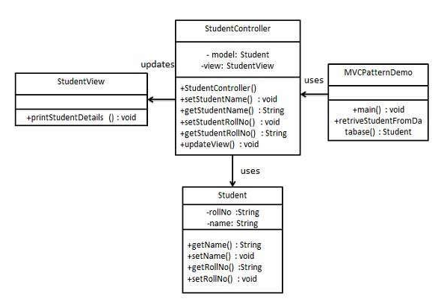
MVC Implementation
10-<number>

Slide 19
A Calculation Example

